Slide 1

Estimating Neighborhood Affluency with Yelp
Shannon Bingham, Roy Kim
January 18, 2019

Slide 2
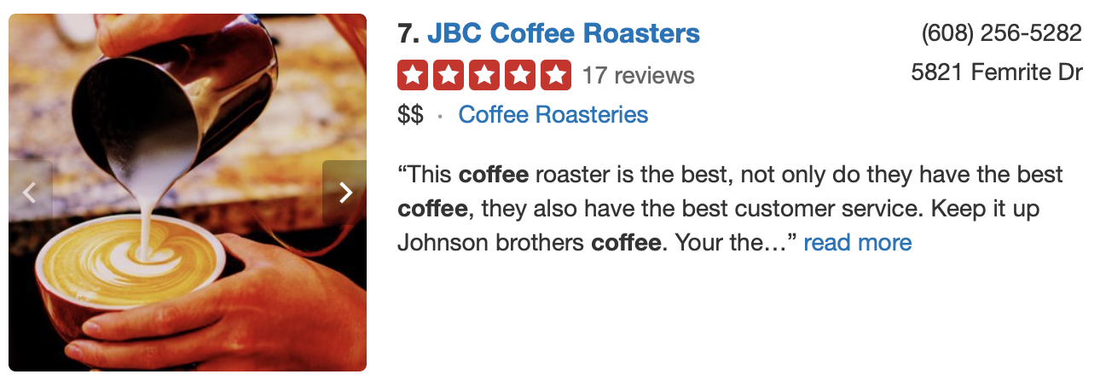
Problem Statement
The goal of the project is to estimate the affluence of a neighborhood based on the number of $ of businesses and services (according to Yelp) in a given neighborhood.

Slide 3
Define Problem
Use Yelp to estimate neighborhood affluency
Collect Data
Yelp
IRS
Explore Data
Feature Engineering
Model Data
Answer Problem
Cleaning Data
Supervised Learning
Yelp as an economic indicator
Data Science Process

Slide 4
1
Define Problem
How can we approach the problem to quantify success?

Slide 5
Introduction
The rise of social apps related to commercial activity has given birth to a wealth of data with many applications.
One of such social apps is Yelp, and the data collected by Yelp is descriptive of businesses by area and location. Specifically, Yelp uses certain markers ($, $$, $$$, $$$$) to indicate the relative cost of the services of a business.
Can this data be used to estimate the affluence of a neighborhood (AGI), or at least be an added indicator to what is already available?

Slide 6
2
Collect Data
Where are we looking for data and how are we getting it?

Slide 7
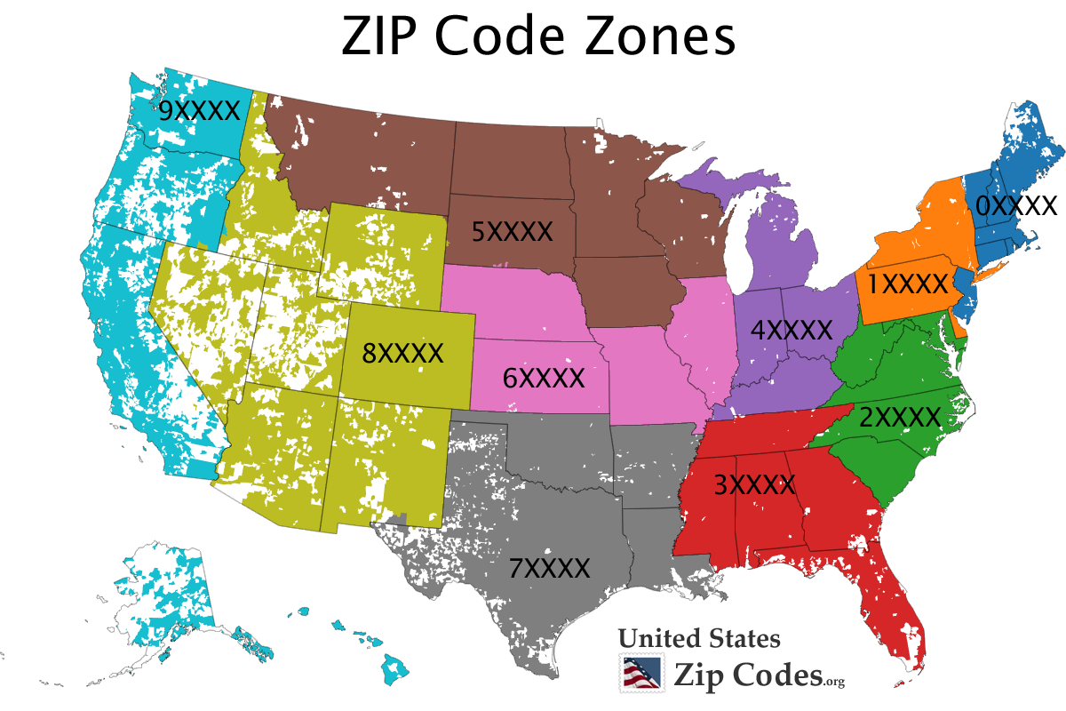
There are 29872 unique zip codes in the U.S.
www.unitedstateszipcodes.org

Slide 8
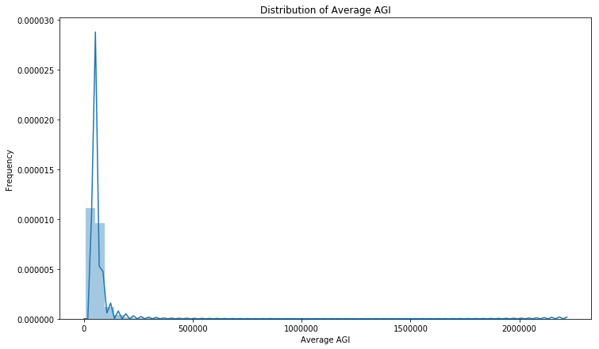
The distribution of average AGI is not symmetrical.

Slide 9
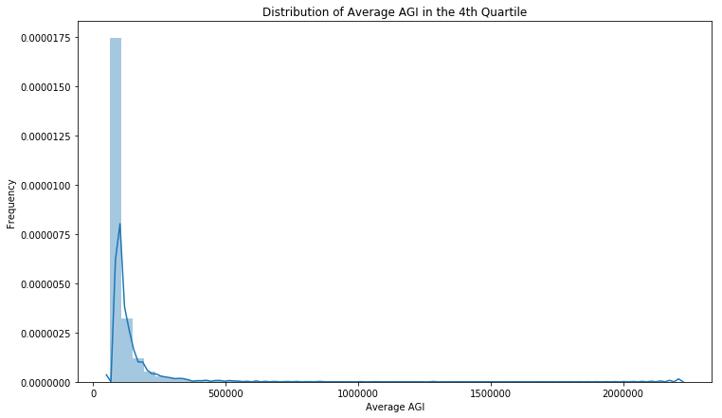
Even among those with the highest average AGI, the distribution is not symmetrical.

Slide 10
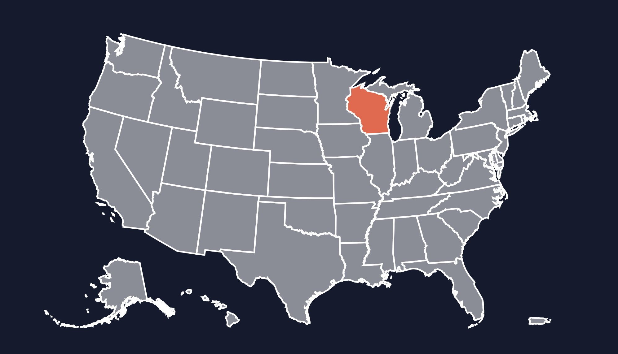
Sample data was selected from Wisconsin.
Average AGI near the median for U.S.
882 zip codes.
Zip codes represent rural and urban areas.
https://datausa.io

Slide 11
Used the basic Yelp interface to get sample data.
Request
for data
data
Advantages: Free
Real-time information
Disadvantages: Limitations on retrieval

Slide 12
3
Explore Data
What does the data tell us?

Slide 13
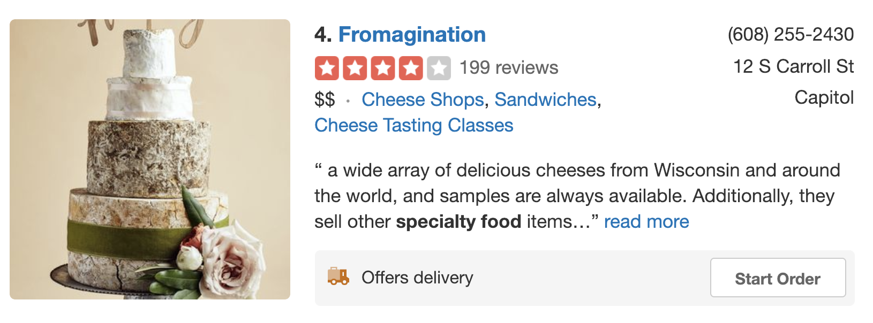
Many records did not have price/rating data.
Average adjusted gross income for 2016
www.yelp.com

Slide 14
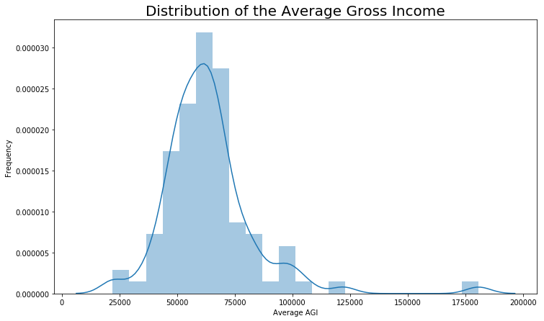
The distribution of average AGI in our sample data was similar to the distribution for the U.S.

Slide 15
Our initial focus was on price and ratings.
Average adjusted gross income for 2016
www.yelp.com

Slide 16


Patterns using only price and rating were too weak to connect to average AGI.
$
www.pixabay.com

Slide 17
Adding the business category showed promise.
$
Business
category
www.pixabay.com

Slide 18
Businesses are classified in one or more categories.
Average adjusted gross income for 2016
www.yelp.com

Slide 19

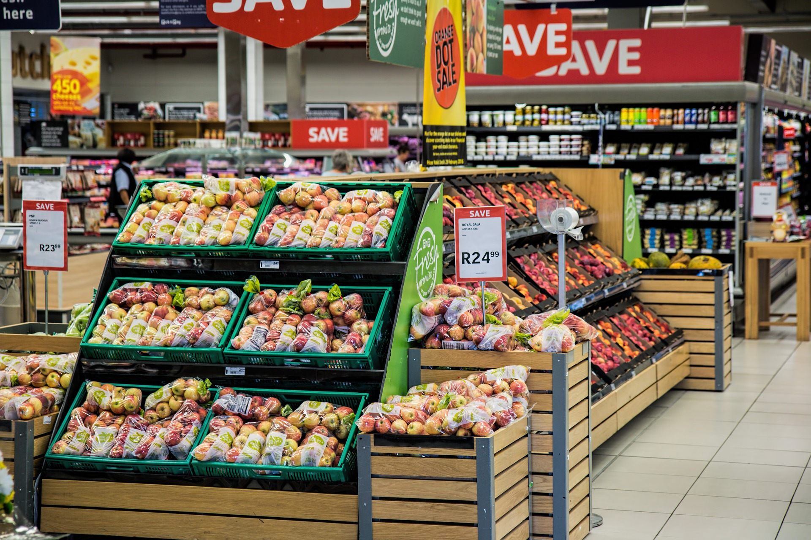

For our sample, three categories stood out.
“Gourmet”
Grocery Stores
Coffee

Slide 20
4
Model Data
How do supervised and unsupervised models make predictions based on the data?

Slide 21
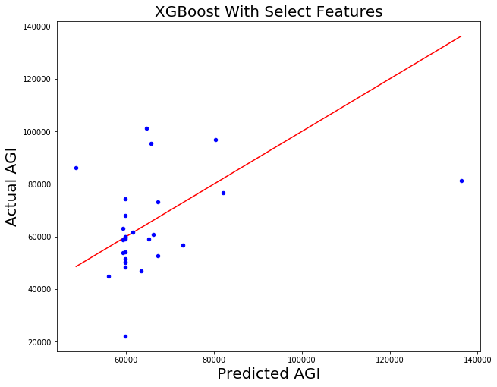
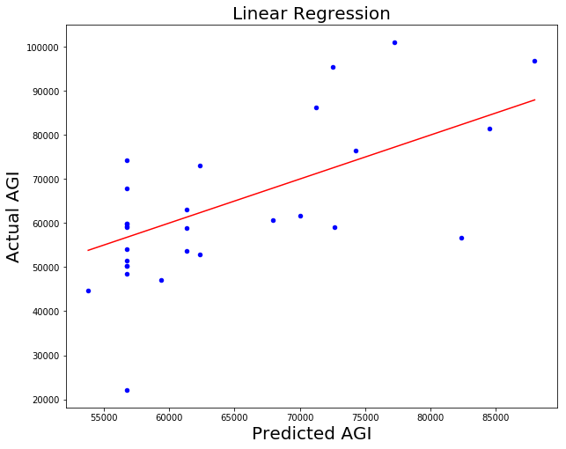
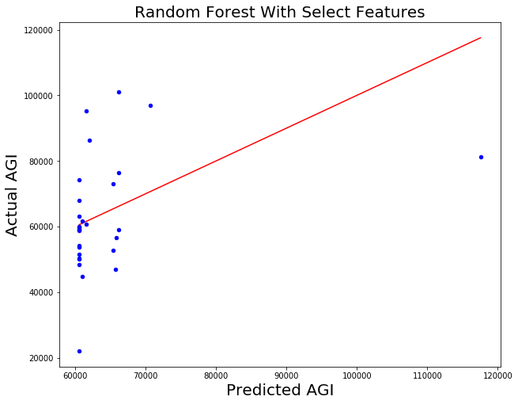
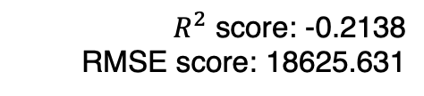
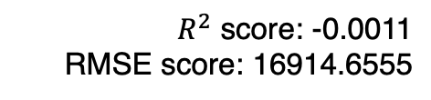
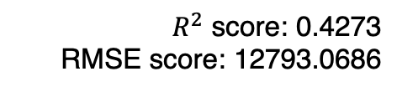
Supervised Learning
Baseline RMSE: 20425.3965
$R^{2}$ score: -0.2138
RMSE score: 18625.631
$R^{2}$ score: 0.4273
RMSE score: 12793.0686
$R^{2}$ score: -0.0011
RMSE score: 16914.6555

Slide 22
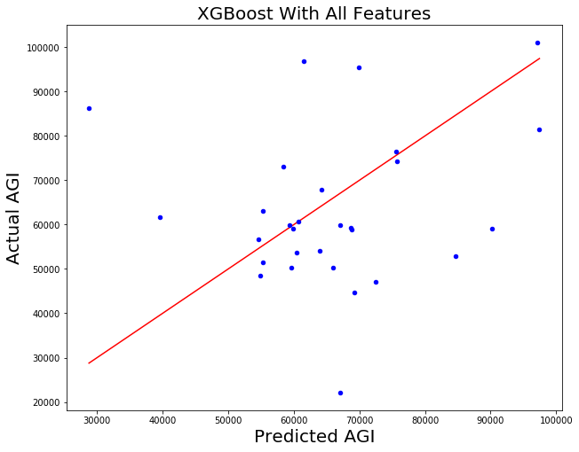
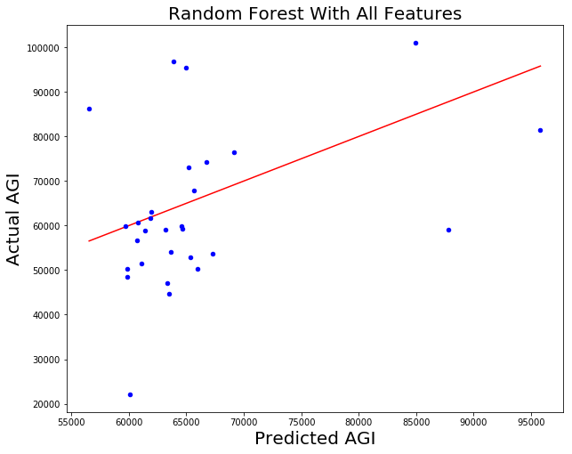
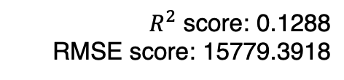
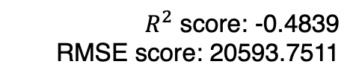
More Supervised Learning
(With all features)
$R^{2}$ score: -0.4839
RMSE score: 20593.7511
$R^{2}$ score: 0.1288
RMSE score: 15779.3918

Slide 23
5
Answer Problem
Does the outcomes of our project address the problem statement?

Slide 24
Conclusions
We believe there is more signal to be seen as more data is gathered and deeper analysis is done.
We conclude that Yelp can be used as a supplementary economic indicator, one more tool to help determine the wealth of a neighborhood.
We believe there is potential for the Yelp data to be used as a a measure of economic growth or shrinkage in an area.

Slide 25
6
Next
Steps
Towards a deliverable

Slide 26
Next Steps
First, having full access to the Yelp API is crucial in obtaining the most amount of data. The basic version of the API limits the data that can be retrieved.
Second, pulling data from other resources, such as the Internal Revenue Service or the US Census, will allow a more informed model.
Lastly, deploying a functional tool by automating the whole process would make our work more accessible and instantly useable. Our model can still be refined further.

Slide 27
Shannon Bingham
Thank
you!
Roy Kim
Any questions?

